Slide 1
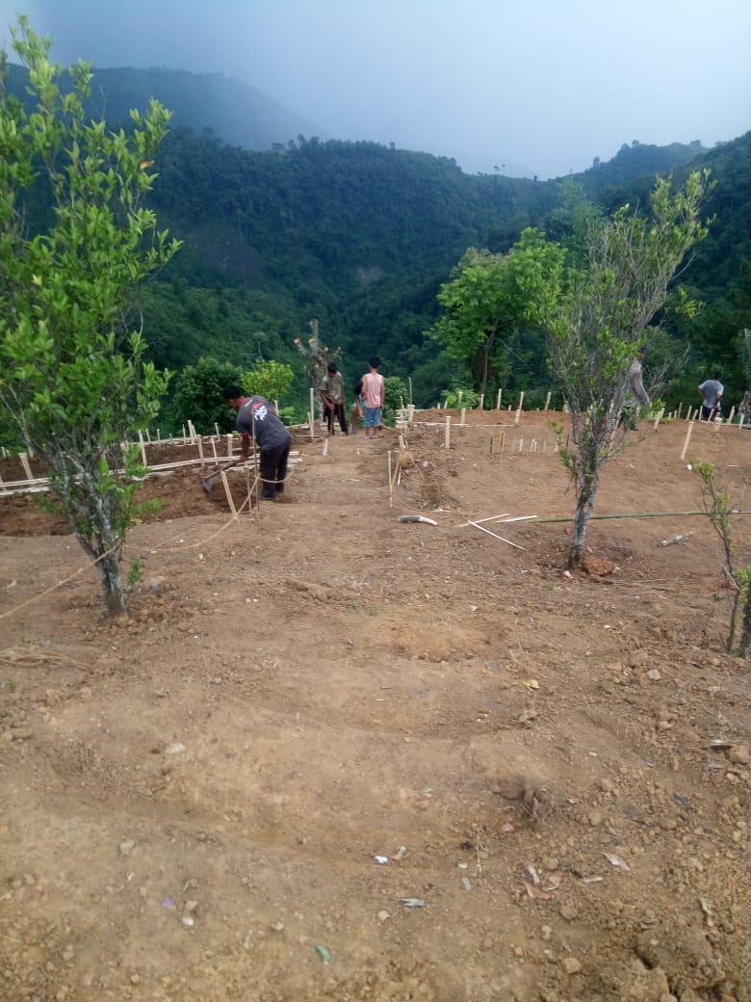
DIVISIONAL MANAGEMENT UNIT
(DMU) PEREN
NFMP
INSIDE LOOK VOL- III NOVEMBER 2019 – APRIL 2020
NFMP Under Peren Forest Division
Sl.No | Range | Batch-1 Village
1. | Peren Range | Mpai Namchi
2. | Tening Range | Nchangram Old Nkio
DMU STAFF
Sl.No | Name | Position
1. | Shri. Obed Zeliang | DFO cum DMU Head
2. | Shri. Hauneu Zeliang | Monitoring , Evaluation & Convergence Expert
3. | Shri. Ileukaibe | Planning & Livelihood Expert
4. | Shri. Agumbe Nring | CB, IEC & Documentation Expert
5. | Smt. Niepusino Chalie | Data Entry/Computer Operator
6. | Shri. Seiminngam | Accounts Assistant
7. | Smt. Khuni | Office Assistant
8. | Shri. Kerialak | Driver
FMU HEAD
Sl.No | Name | Range/ Beats
1. | Shri. Namsibo RFO | Tening
2. | Shri. Nungsangtemjen Dy. RFO | Peren

Slide 2
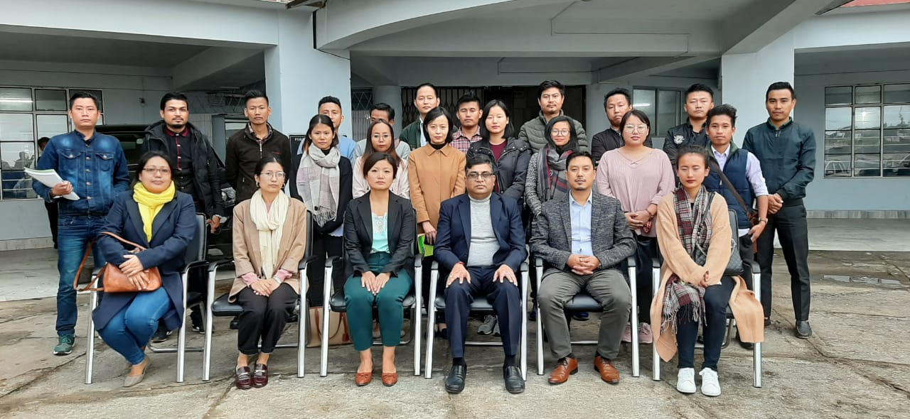
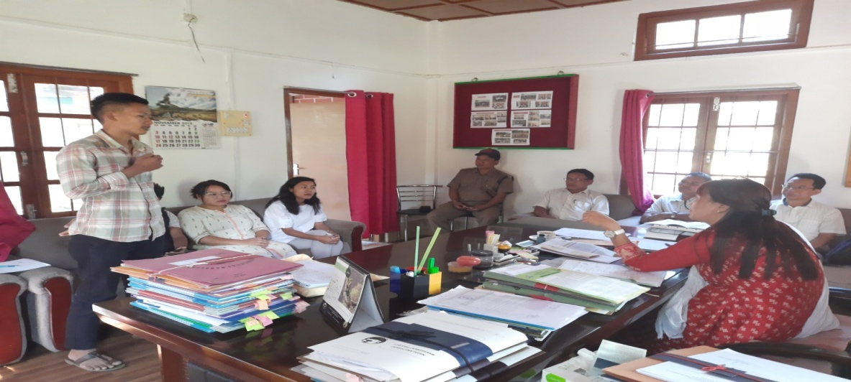
TRAINING CUM ORIENTATION PROGRAM FOR DMU SUPPORT STAFF
DMU support staff attended one day training cum orientation program on 13th November 2019 at Forest Office complex, Kohima conducted by project Management Consultant (PMC).
MEETING OF DMU STAFF AND FMU HEAD
Experience sharing session for DMU support staff after attending training cum orientation program was held on 14th November 2019.

Slide 3
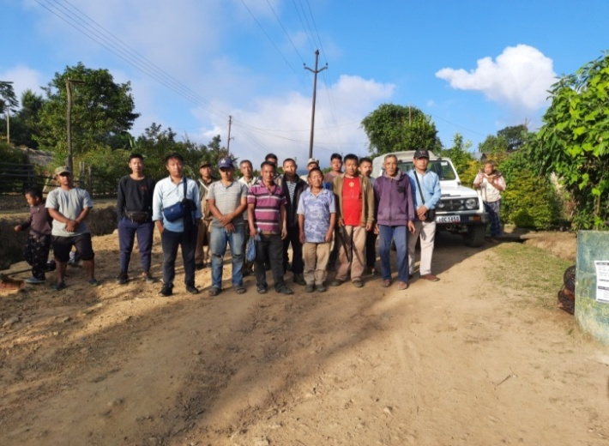
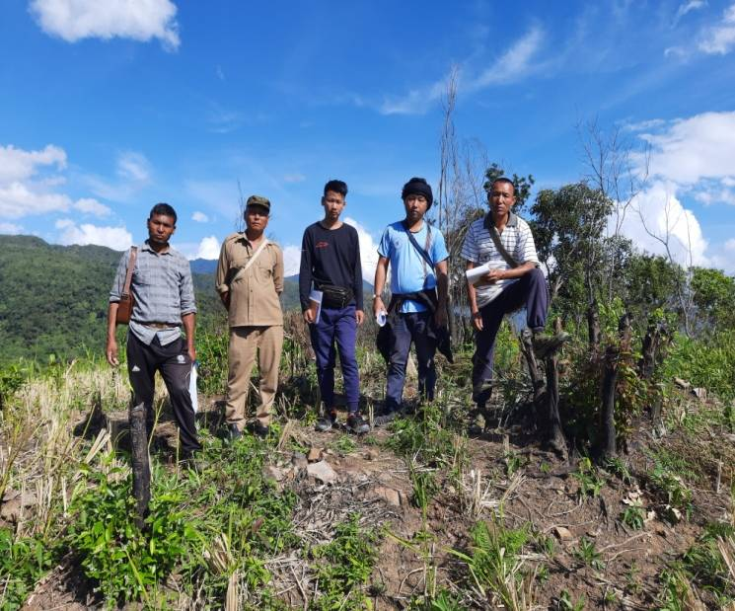
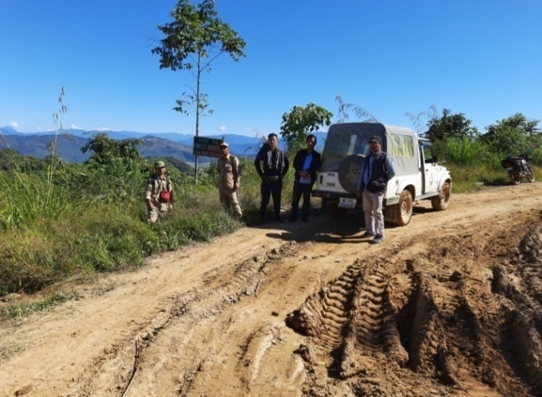
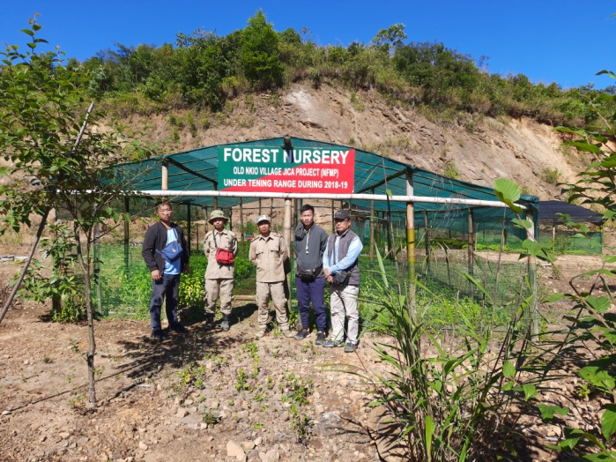
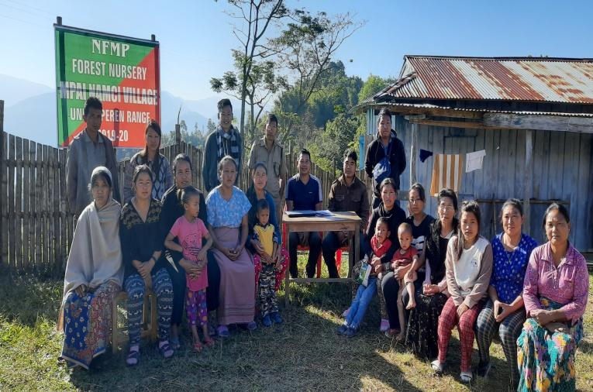
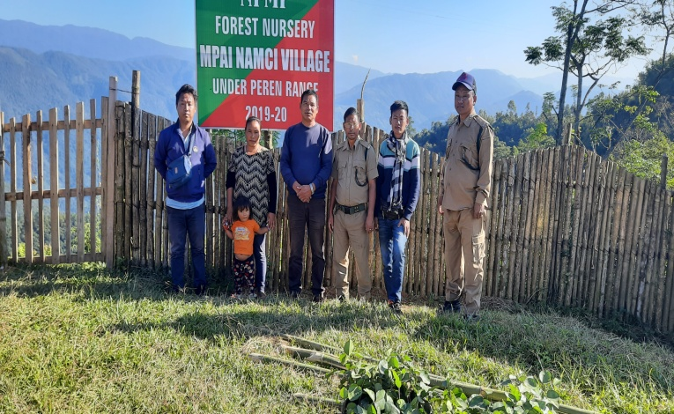
Field visit by DMU support staff Peren along with Field Management Unit for Batch 1 villages for introduction to the project works and interaction with JFMC members
1. Nchangram Village 19th November, 2019
2. Old Nkio Village 21st November, 2019
3. Mpai Namci Village 24th November, 2019

Slide 4
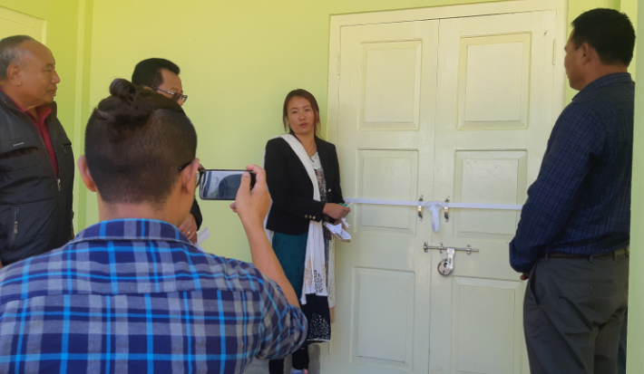
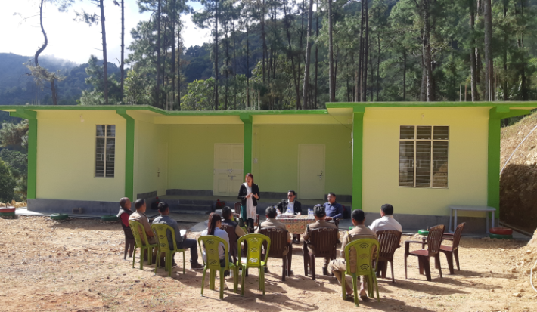
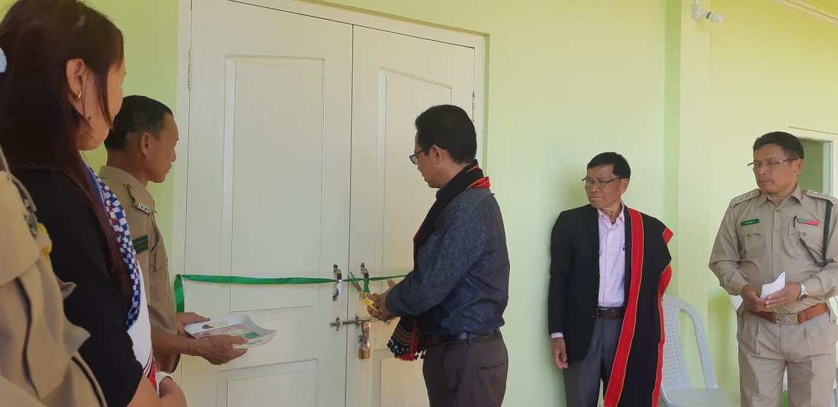
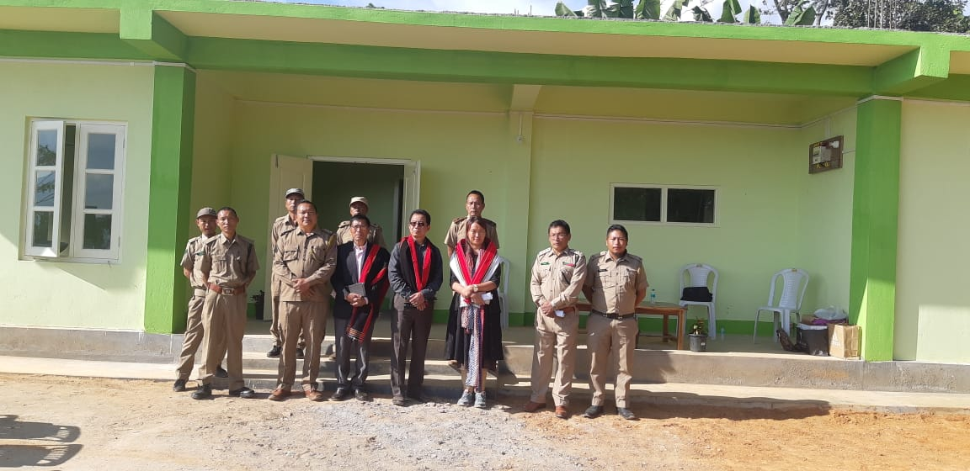
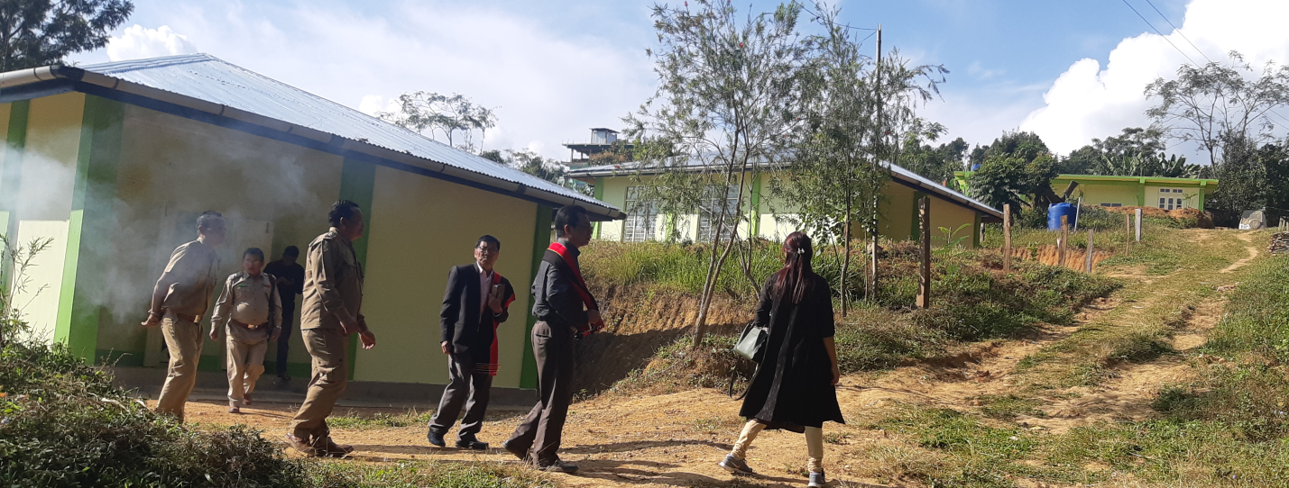
With the dedicated effort of the FMU and staff the construction of Range Level offices and Staff quarters funded by NFMP were successfully completed and officially inaugurated in November 2019.
Range Office Building, Peren inaugurated by Dr. Sentitula IFS, DFO Peren on 20th November, 2019
Range Office Building, Tening inaugurated by M.Obed Zeliang ADMU, Peren on 25th November, 2019
Row of staff quarters constructed under NFMP at Tening Forest Colony

Slide 5
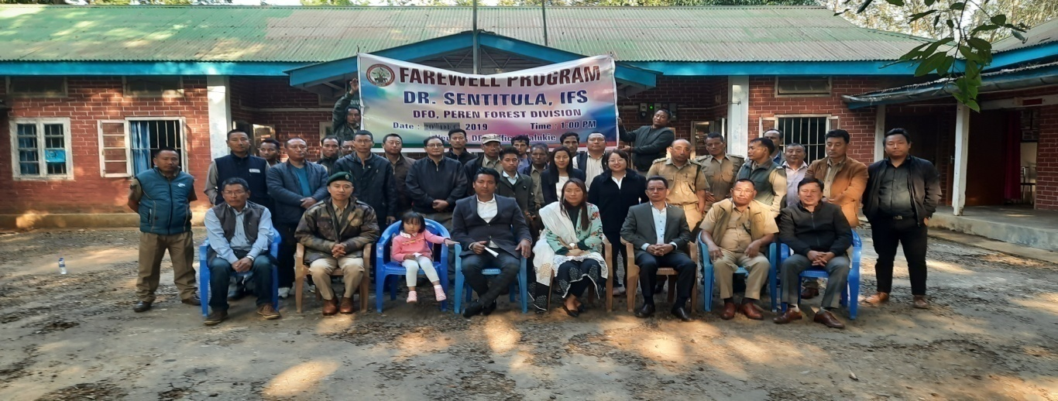
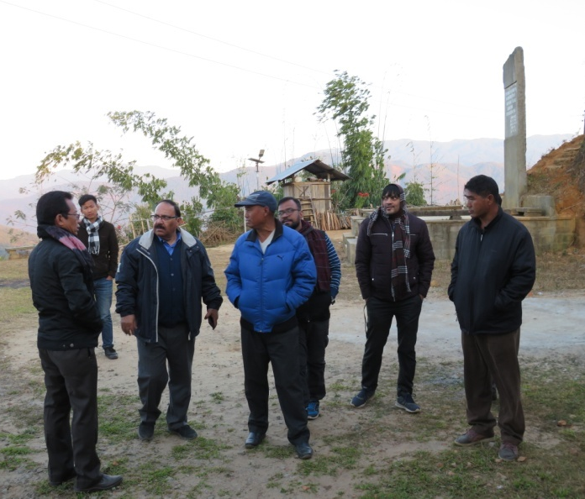
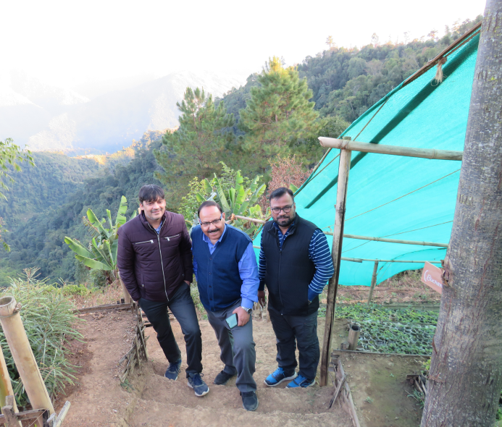
Divisional staff along with DMU Support staff organized a farewell function for the outgoing DFO cum DMU Head Peren Dr. Sentitula IFS on 20th December 2019 at Divisional Forest Office Jalukie.
PMC Field Visit
PMC team lead by V. Arora visited Batch – I villages under Peren Division Viz. Nchangram Village under Tening Range and Mpai Namci Village under Peren Range on 23rd January 2020.
PMC team was accompanied by Shri. M.Obed Zeliang, DMU Head Peren with 2 FMUs Shri. Namsibo FMU Tening and Shri. Nungsangtemjen FMU Peren along with 2 DMU support staff Shri. Agumbe, Documentation Expert and Shri. Ileukaibe, Planning and Livelihood Expert.

Slide 6
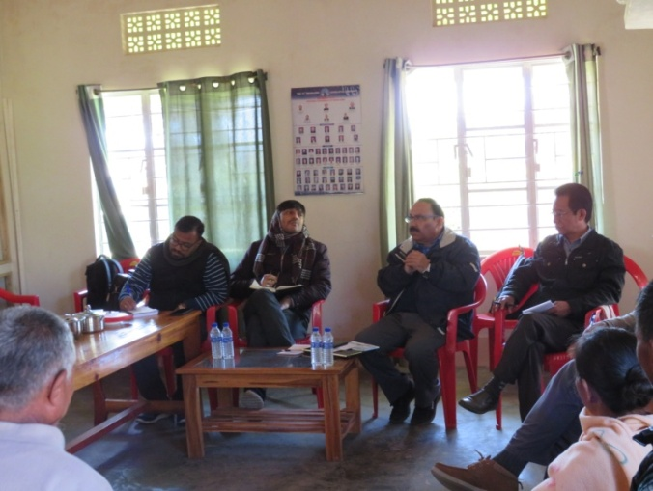
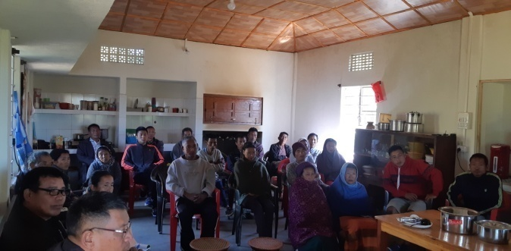
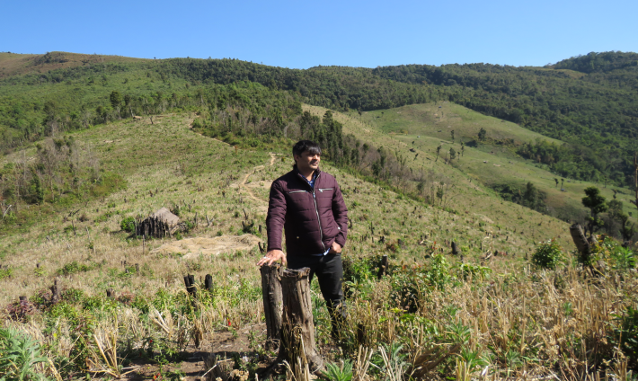
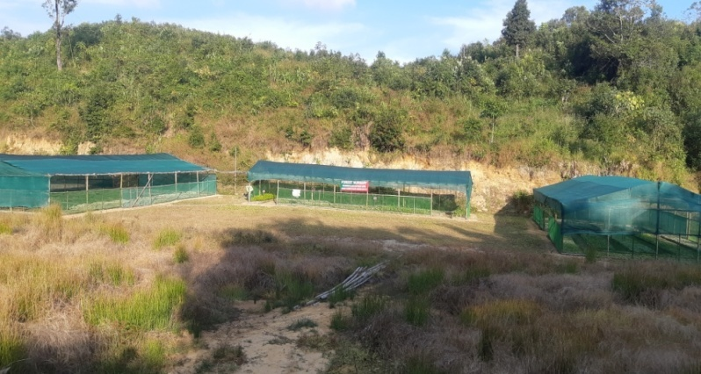
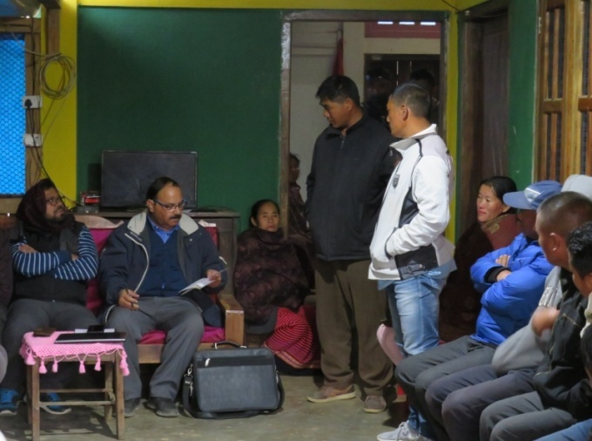
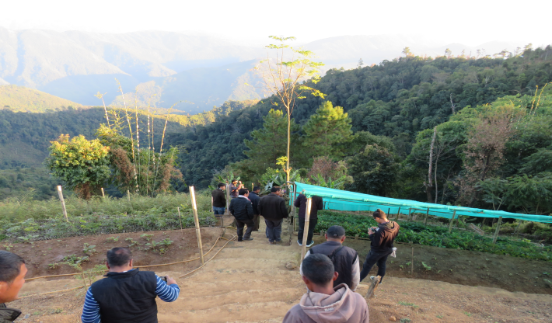
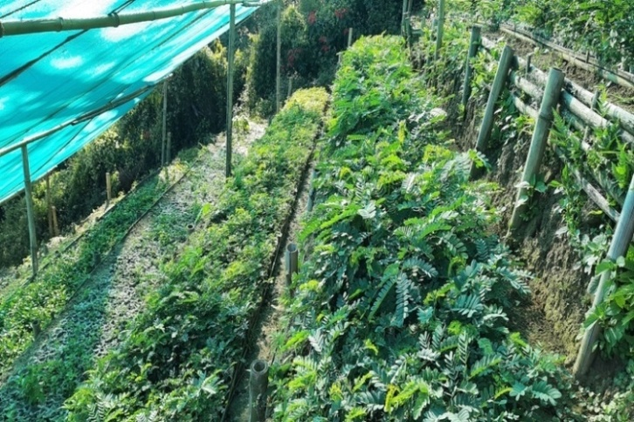
PMC Team along with DMU Head interactions with JFMC Members, Youth & SHG Members and visit to Nursery & Treatment site.
Nchangram Village under FMU Tening
Mpai Village under FMU Peren

Slide 7
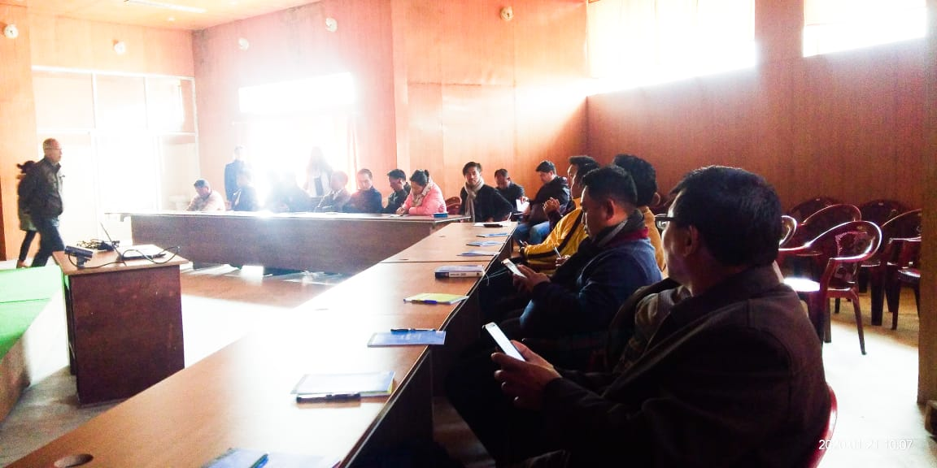
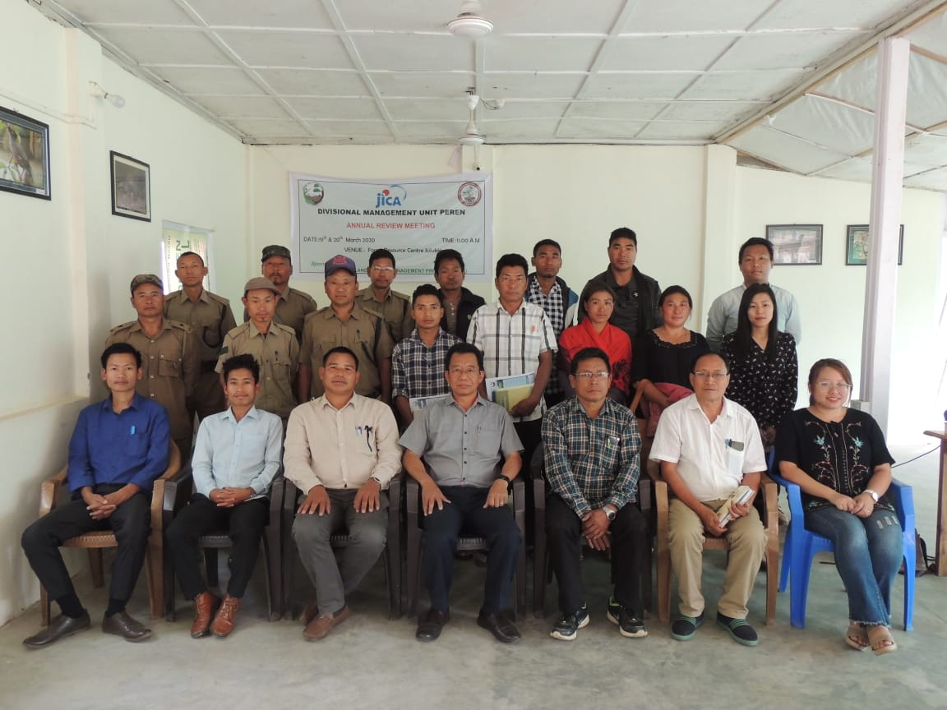
Training on Accounting and Office Procedures held on 21st January, 2020 at Forest Office Complex, Conference Hall, Kohima
Divisional Level Annual Review Meeting
(19th & 20th March 2020)
DMU Peren conducted Divisional Level Annual Review Meeting on 19th & 20th March 2020 at the Forest Resource Centre, Jalukie.

Slide 8
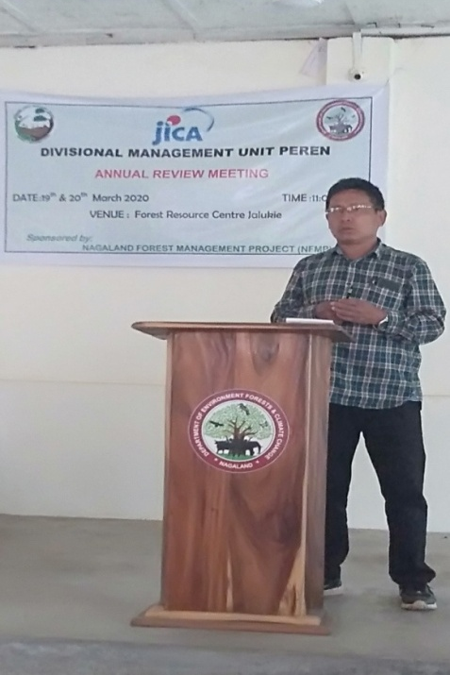
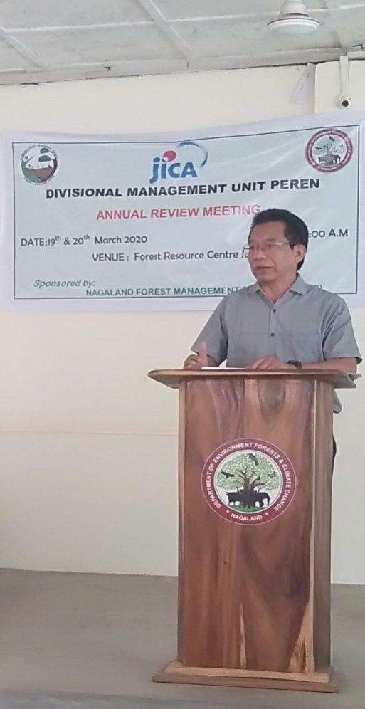
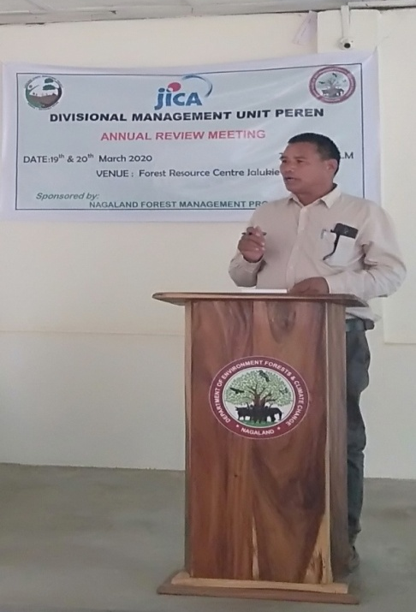
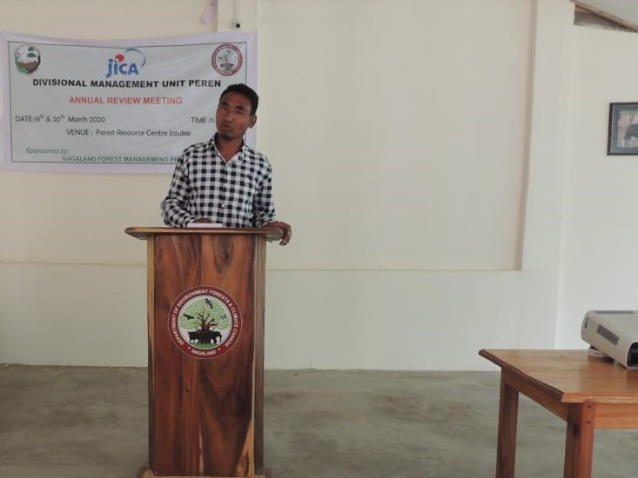
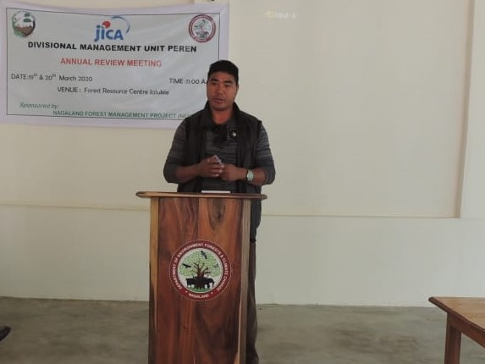
Shri. Namsibo FMU Tening, presenting activities report
DFO Cum DMU Head Peren Shri. M. Obed Zeliang, delivering the key note address.
Shri, Nungsangtemjen FMU Peren, presenting activities report
JFMC Chairman of Project Villages sharing their experiences in the meeting

Slide 9
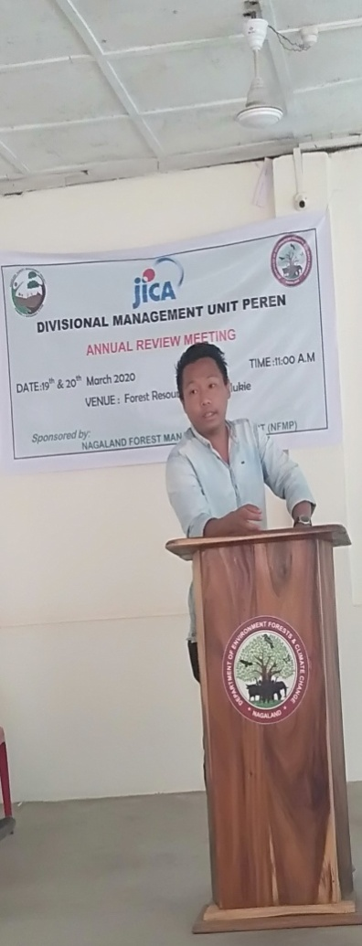
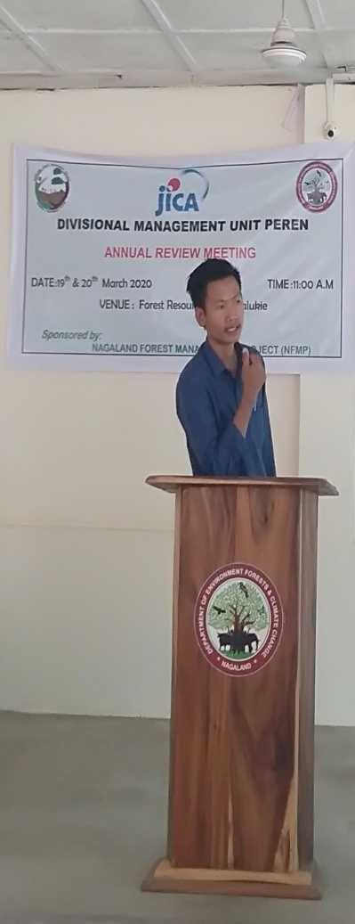
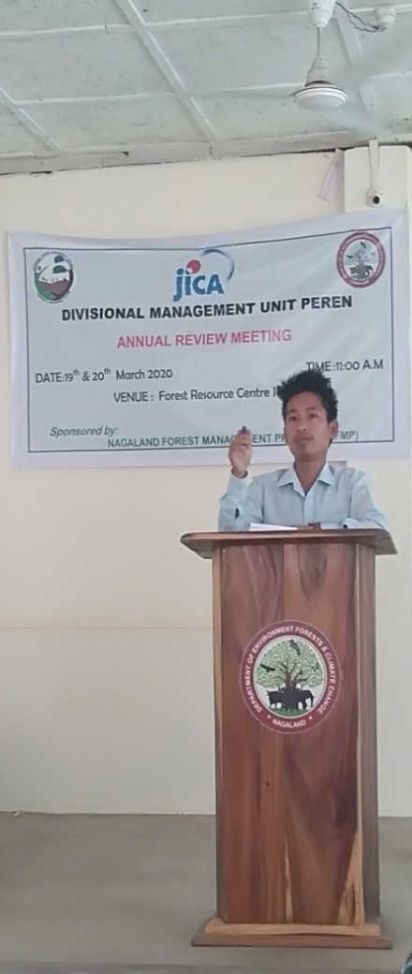
Shri. Agumbe Nring DMU-03, presentation on annual activity report.
Shri. Ileukaibe,
DMU-01 presentation on improvement and suggestion of the project
Shri. Seiminngam, Account Asst. presentation on maintenance of cash book, cheque book, ledger account, etc.
Contact address:
Divisional Forest Office
Keleilwa Colony
Jalukie Town
Peren: Nagaland
E-Mail: dmuperen@nfmpjica.org

